Slide 1


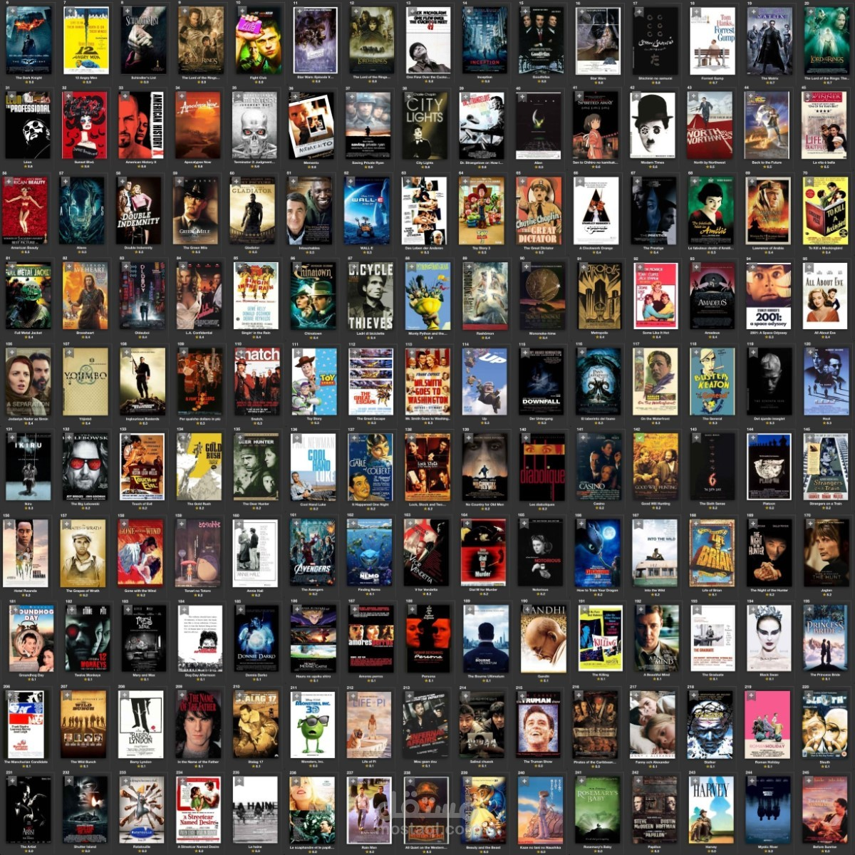
Movies Hybrid Recommender System using Deep

Slide 2
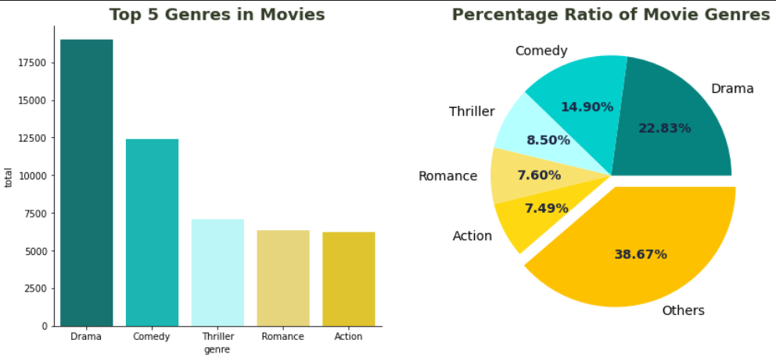
Data Visualization (Top 5 Genres in Movies)

Slide 3
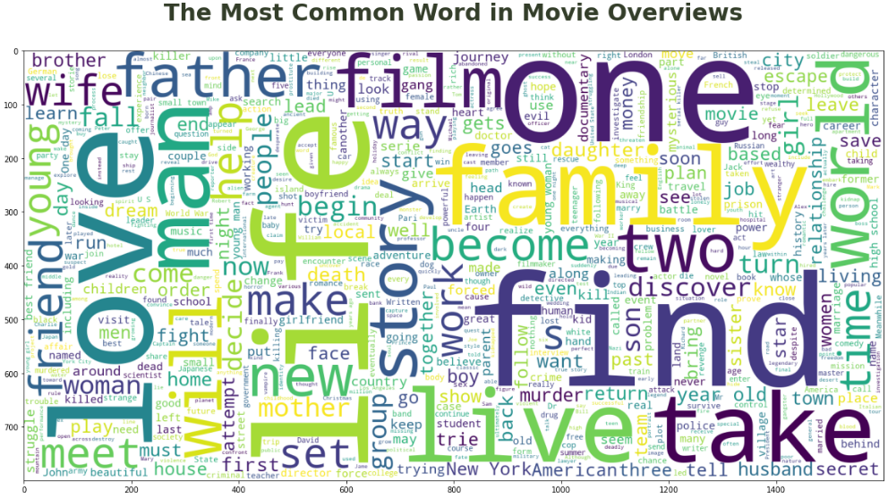
Most Common Words

Slide 4
Introduction to Recommender Systems
What Are Recommender Systems?
Systems that suggest items (e.g., movies, music) based on user preferences.
Types:
Collaborative Filtering: Uses user behavior (e.g., ratings) to find patterns.
Content-Based Filtering: Uses item features (e.g., genres) for recommendations.
Hybrid: Combines both for better accuracy.
Importance: Enhances user experience on platforms like Netflix, Amazon.
In our system we are using Hybrid Recommender System

Slide 5
Project Overview
Our Movie Recommender System
Goal: Recommend movies users will enjoy using ratings and movie metadata.
Approach: Hybrid model combining:
Collaborative filtering (user ratings).
Content-based filtering (genres, keywords).
Features:
Predicts movie ratings (0.5 to 5).
Identifies relevant movies (rating > 3.5).
Suggests top movies and similar films.
Built with Python, TensorFlow, and Pandas.
Flowchart: Data → Neural Network → Recommendations.
Example output: “User 123: Predicted rating Finding Nemo (4.2 stars).”

Slide 6
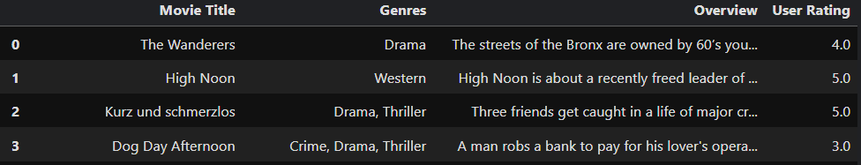
Data Preprocessing
Preparing the Data
Datasets (from Kaggle’s MovieLens):
Movies: ~43,000 (ID, title, genres, overview).
Ratings: ~100,000 (user ID, movie ID, rating).
Keywords: Top 1000 keywords for movies.
Steps:
Clean data: Remove duplicates, missing values, for the missing values was Overview.
Parse genres/keywords from JSON-like strings.
Merge ratings with movie metadata.
Add negative sampling: Unrated movies (rating 0.5) to balance data.
Output: Clean dataset with user, movie, genre, and keyword indices.
Visuals:
Table showing sample data (e.g., Movie: Toy Story, Genres: Animation, Comedy, Rating: 4.0).
Diagram of data merging process.

Slide 7
How Embeddings Work
Understanding Embeddings
What Are Embeddings?: Numerical vectors representing users, movies, genres, keywords.
Role: Capture patterns (e.g., users who like action movies have similar vectors).
In Our Project:
User/Movie Embeddings: 256 dimensions, learned from ratings.
Genre/Keyword Embeddings: 32 dimensions, learned from movie features.
Example: Toy Story’s genres (Animation, Comedy) → averaged vector.
Process: Embeddings are fed into a neural network to predict ratings.

Slide 8
Neural Network Architecture
Building the Neural Network
Inputs: User index, movie index, genre sequence, keyword sequence.
Embeddings:
Users/Movies: 256D vectors, L2 regularization to prevent overfitting.
Genres/Keywords: 32D vectors, averaged across sequences.
Layers:
Concatenate embeddings (576D vector).
Dense layers (128, 64, 32, 16 units) with ReLU, batch normalization, dropout (0.3).
Outputs:
Rating: Predicted score (0.5 to 5).
Relevance: Binary (1 if rating > 3.5).

Slide 9
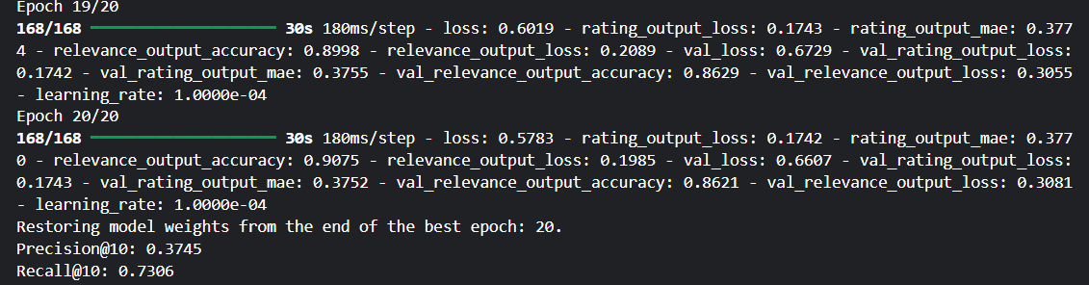
Training and Evaluation
Training and Evaluating the Model
Training:
80-20 train-test split, batch size 512.
Early stopping (patience 3) and learning rate reduction (factor 0.5).
Up to 20 epochs, Adam optimizer (learning rate 0.0001).
Evaluation:
Precision@10: % of top-10 movies with true ratings > 3.5.
Recall@10: % of relevant movies in top-10.
Example: Precision@10: 0.38, Recall@10: 0.73.
Visuals:
Plot of training/validation MAE over epochs.
Table: Metric | Value (e.g., Precision@10 | 0.7500).

Slide 10
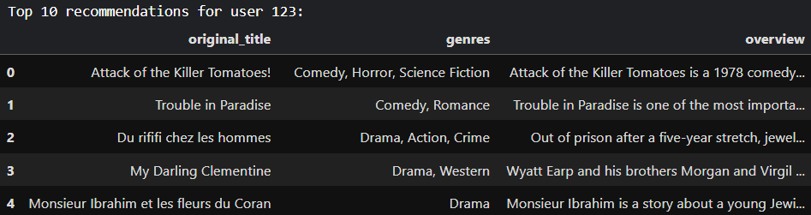
Recommendation Functions
Making Recommendations
Predict Rating: Predicts rating for a user-movie pair (e.g., “User 123: Toy Story → 4.2”).
Top-N Recommendations: Suggests top-N movies (rating > 3.5 or highest-rated).
Similar Movies: Finds movies similar to a given title (using Jaccard similarity), personalized by predicted ratings.
User History: Displays rated movies with genres and overviews.
Visuals:
Table: Top-5 recommendations for User 123 (Movie, Genres, Overview).
Example: “Similar to Toy Story: Finding Nemo, Cars.”

Slide 11
Research Context and Advantages
Why This System Stands Out
Research Context:
Aligns with hybrid models like HRS-IU-DL (Nature, 2024, Precision: 0.8127).
Uses embeddings like Neural Collaborative Filtering (He et al., 2017).
Advantages:
Handles cold-start with genre/keyword embeddings.
Multi-task learning improves accuracy.
Negative sampling balances data.

Slide 12
Conclusion and Future Work
Conclusion and Next Steps
Summary: A hybrid recommender system that personalizes movie suggestions using deep learning.
Key Strengths: Combines user preferences and movie features, robust to cold-start, user-friendly.
Future Work:
Add sequential modeling (RNNs, Transformers).
Include more metadata (cast, director).
Improve scalability for larger datasets.

